Slide 1

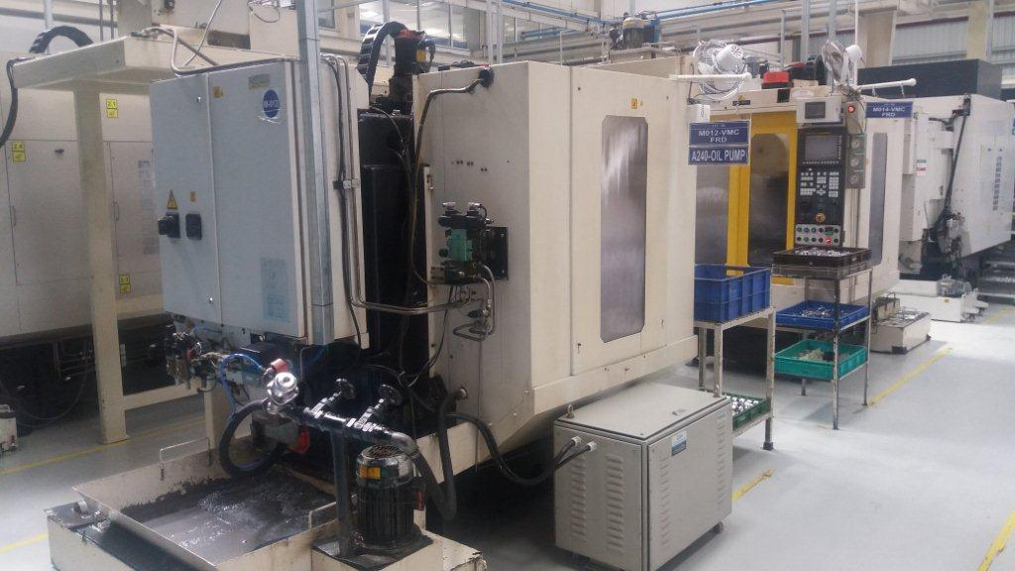
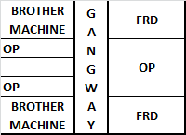
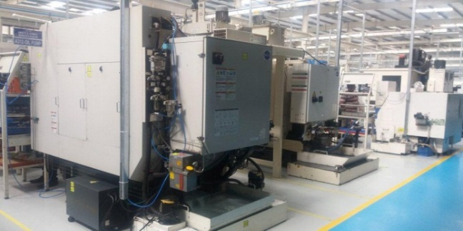
P15
KAIZEN NO :- 16
ACTIVITY
KK
QM
PM
JH
SHE
OT
DM
E&T
KAIZEN IDEA SHEET
TPM CIRCLE NAME: Achiever
LOSS NO. / STEP
DEPT :- MACHINE SHOP
RESULT AREA
P
Q
A,B,C
C
D
S
M
CELL:- Oil Pump
CELL NAME:- A312 Body
MACHINE / STAGE :- Brother Machine
OPERATION :- Machining.
KAIZEN THEME : To Reduce Manpower.
IDEA :- Lay out Change.
Problem / Present Status :-
In Present Lay Out Low Cycle time Product Brt Machine Available in front of High Cycle time Product FRD Machine due to this we required 2 separate operator for Machine.
COUNTERMEASURE :- High Cycle time Product Machine Arrange in one Area (Location).
BENCHMARK
2operator for 2machine
After
TARGET
1operator for 2machine
KAIZEN START
10.05.2016
KAIZEN FINISH
15.05.2016
TEAM MEMBERS :
Umesh Pimple, Dilip Phapale , Sachin C.
BENEFITS :-
1)Increases productivity man/day
2)Manpower Cost save 1/shift
Brother machine
FRD machine
FRD machine
KAIZEN SUSTENANCE
WHY - WHY ANALYSIS :-
Why1 :- Separate operator for Separate Machine.
Why2 :- Operator Unable to Run Both Machine.
Why3 :- Low & High combination cycle time Product machine Arrangement in Lay Out.
RESULT :-
1) Manpower Saving 1/Shift.
2) Manpower Cost Reduction.
WHAT TO DO:- N.A
HOW TO DO:- N.A
ROOT CAUSE :- Low & High combination cycle time Product machine Arrangement in Lay Out.
REGISTRATION NO. & DATE : 15.05.2016
SCOPE & PLAN FOR HORIZONTAL DEPLOYMENT
REGISTERED BY :- Umesh Pimple
SR.
NO.
CELL
TARGET
RESPONSIBILITY
STATUS
MANAGER’S SIGN :- D. Y. Pawar
1
All 04
FRD
15.5.16
SC
Comple
te.

